Slide 1
Multifamily Market
Steve Woodyard
Woodyard Realty Corp.

Slide 2

What drives the market?
Jobs
Interest Rates
Financing
Low supply of new housing
New home owner credit and desire
Changing demographics
Technology

Slide 3
Timeline of Woodyard Realty Corp.’s Sales to
Out-of-State Investors Versus Local Investors
1984 – 2000
2001 – Oct 5, 2014
Local Investors
90%
Out of State
10%
Local
Investors
47%
Out of State
Investors
53%

Slide 4
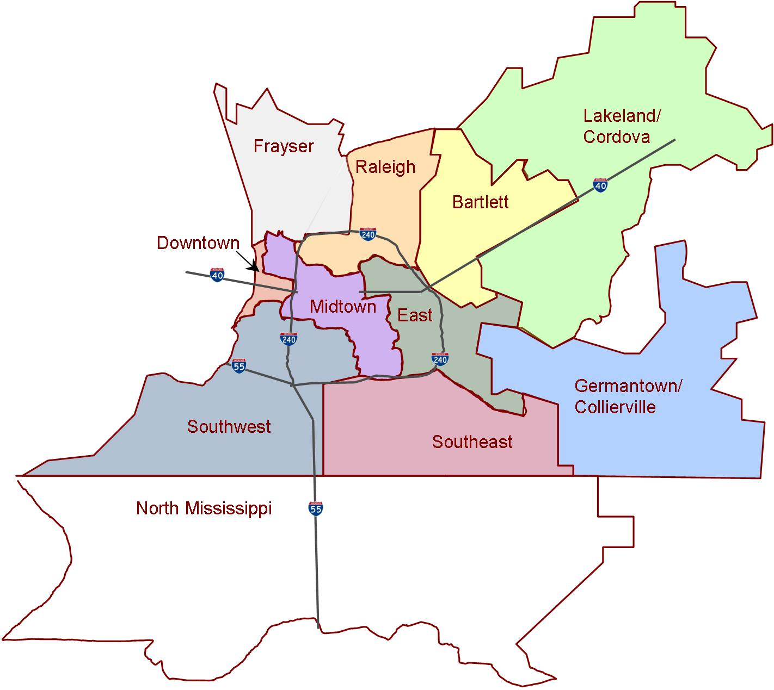
Memphis Submarkets
Bartlett 38134, 38135, 38133
Collierville/Germ 38017, 38138, 38139
Cordova/Lakeland 38016, 38018, 38002
Downtown 38103, 38105, 38157
East 38119, 38120, 38122, 38117
Frayser 38127
Midtown 38104, 38107, 38111, 38112
North Mississippi 38632, 38637, 38654, 38671, 38664, 38680, 38676
Raleigh 38108, 38128
Southeast 38115, 38118, 38125, 38141
Southwest 38106, 38109, 38114, 38116, 38126,38132, 38131
as defined by Apartment Association of Greater Memphis

Slide 5


June 30, 2013; Information not been verified
*Distressed assets are defined as properties with unusually low occupancy (less than 65% occupancy).

Slide 6
Local Multifamily Market: 2014 Review (Jan-Oct 5, 2014)
Foreclosures by Submarket
7 Foreclosures
Type of Transaction
28 Sales plus 7 Foreclosures
Raleigh - 1
Foreclosures
7
East - 2
Frayser - 3
Normal
22
REO/Distressed
6
Southwest- 1
30+ apartment units in Greater Memphis Metropolitan Area

Slide 7
Local Multifamily Market: 2014 Sales (Jan-Oct 5, 2014)
28 Sales Transactions
32 total sales in 2013
$219.4 Gross Sales Volume (in Millions)
$239.3 total gross sales volume in 2013
5,487 Units Sold
6,513 total units sold in 2013
$39,977 Average Price per Unit
$36,757 total avg. price/unit in 2013
Bartlett
7%
Cordova/
Lakeland
7%
Southeast - 14%
East 7%
Southwest - 14%
Frayser 4%
Raleigh 4%
Germ./Collierville 4%
Midtown -39%
30+ apartment units in Greater Memphis Metropolitan Area

Slide 8
Local Multifamily Market: 2001-Oct. 5, 2014 Sales in Review
$370
$345
$323
$293
13-Yr Average*
$195.9 Million
$239
$206
$219
$188
$174
$125
$105
$59
$65
$55
13-Yr Average*
40 Transactions
* Does not include 2014
30+ apartment units in Greater Memphis Metropolitan Area

Slide 9
Local Multifamily Market: 2010-Oct 5, 2014 Sales in Review
Broken Down by Product Class
$323
$239
$206
$219
10
$233
4
$73
4
$101.7
Volume in Millions
5
$135
28
$166
24
$117.7
$55
30
$90
1 - $16
32
$71
28 - $39
2014
Class A - B+ Properties
Class B - D Properties
30+ apartment units in Greater Memphis Metropolitan Area

Slide 10
Local Multifamily Market: 2001 – 2014 Construction
# of Units
14-Yr Average
1176 Units
30+ apartment units in Greater Memphis Metropolitan Area

Slide 11
Local Multifamily Market: New Construction
Downtown Area
Printer’s Alley & Annex 54 UC
South Junction Apts 197 UC
Toof Apts 50 UC
The Chisca Apts 165 UC
Crescent Bluff 172 UC
Harbor Isle 134 UC
Artspace Memphis 44 PL
Uptown Apts 90 PL
362 S Second 64 PL
French Fort 67 PL
University of Memphis Area
Gather on Southern 74 CP
3595 Southern 64 UC
Highland Row 354 PL
Midland Apts 120 PL
Doyle Apts 127 PL
Collierville Area
Westbrook Crossing 227 CP
Carrington Apts 112 CP
Signature Apts 251 UC
Under Construction
Apts – Planning Stages
CP – Completed Project
UC – Under Construction
PL - Planned

Slide 12
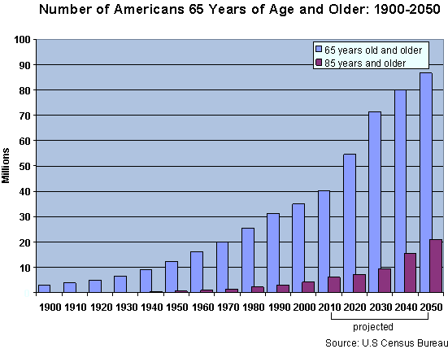
Trends Improving the Rental Demand
Baby Boomers Scaling Down, Entering Rental Market
In the United States, the baby boom generation represents 76 million people.
On January 1, 2011, as the
baby boomers began to
celebrate their 65th birthdays,
10,000 people turned 65
every day— this will continue
for next 16 years.

Slide 13
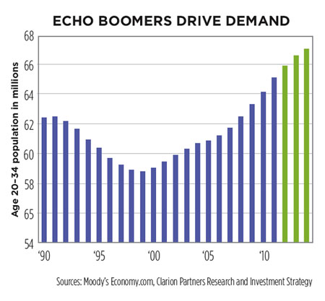
Trends Improving the Rental Demand
More Renters Entering the Market - Generation Y
Generation Y, the echo boom of the baby boomers, born from 1977-2001 (estimated majority are between 18-30 years old)
Nearly 80 million in population (larger than the baby boomer population of 72 million)
13%
Own
27%
Live with
Relatives
60% Rent

Slide 14
Local Multifamily Market: Mid Year 2014
Rent Trend
*
Occupancy Trend
*
* Apartment Association of Greater Memphis includes foreclosures and out of service apartments for the first time

Slide 15
Market Cycle as Projected by Integra Realty Resources
Recovery
Expansion
Hyper Supply
Recession
3
1
1
1st Stage of the Phase
2
2
2nd Stage of the Phase
Integra
Memphis
2
3
3rd Stage of the Phase
1
Out of State
3
IRR - Memphis Metro
- Decreasing Vacancy
- Moderate/High New Construction
- High Absorption
- Moderate/High Employment Growth
- Medium/High Rental Rate Growth
Local
Investors
3
Local Investors
WRC
30+ units
1
2
2
Woodyard Realty - Memphis Metro
- Decreasing Vacancy
- Low to Moderate New Construction
- Moderate/High Absorption
- Low/Moderate Employment Growth
- Low/Medium Rental Rate Growth
1
3
Recovery Phase
Decreasing Vacancy Rates
Low New Construction
Moderate Absorption
Low/Moderate Employment Growth
Neg/Low Rental Rate Growth
Expansion Phase
Decreasing Vacancy Rates
Moderate/High New Construction
High Absorption
Moderate/High Employment Growth
Med/High Rental Rate Growth
Hyper Supply Phase
Increasing Vacancy Rates
Moderate/High New Construction
Low/Negative Absorption
Moderate/Low Employment Growth
Med/Low Rental Rate Growth
Recession Phase
Increasing Vacancy Rates
Moderate/Low New Construction
Low Absorption
Low/Neg Employment Growth
Low/Neg Rental Rate Growth

Slide 16

Woodyard Realty Corp.’s 2015 Forecast
Each submarket will have improving conditions
Similar and slightly declining levels of foreclosures
Increasing levels of new construction
Modestly increasing rents that are gaining momentum
Improving Occupancy
Prices have hit bottom and are improving
Two possibly three years left to find value-add opportunities

